Slide 1

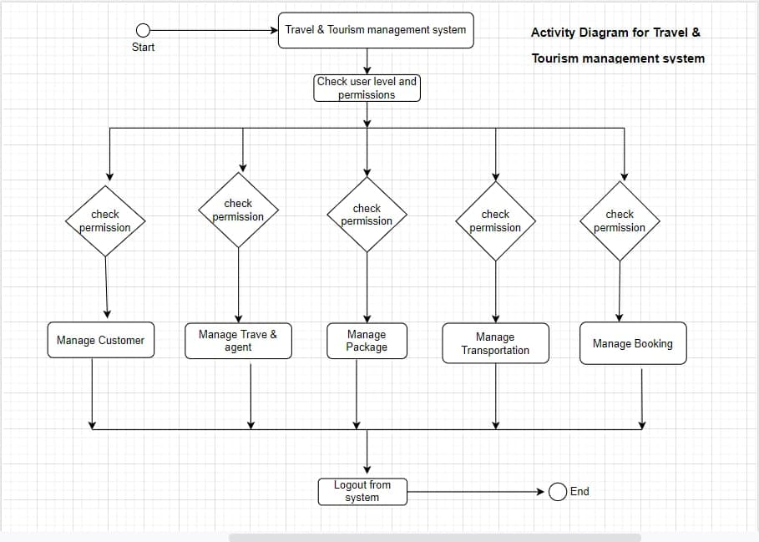
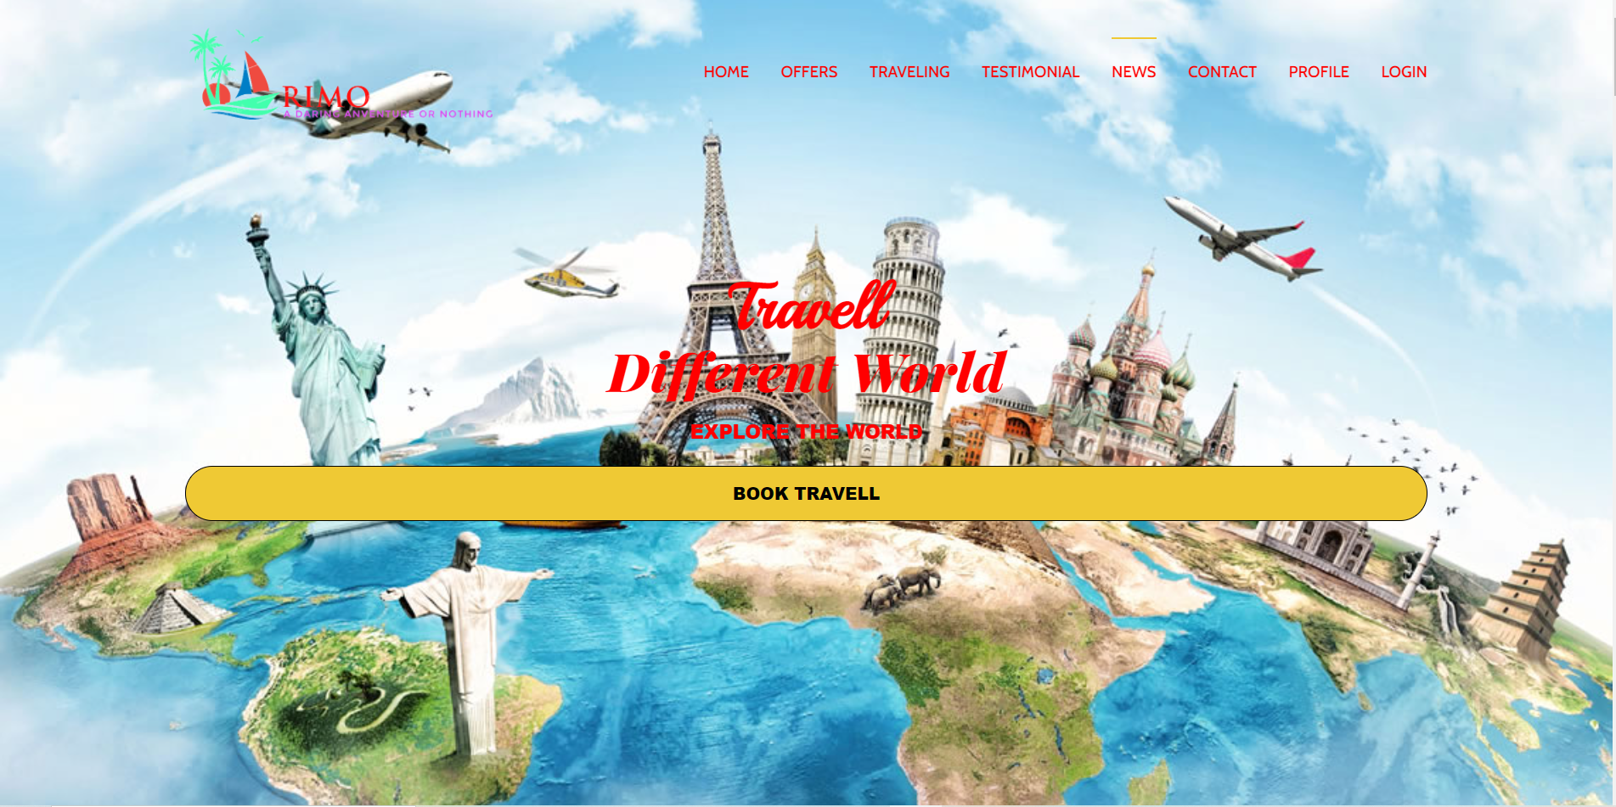
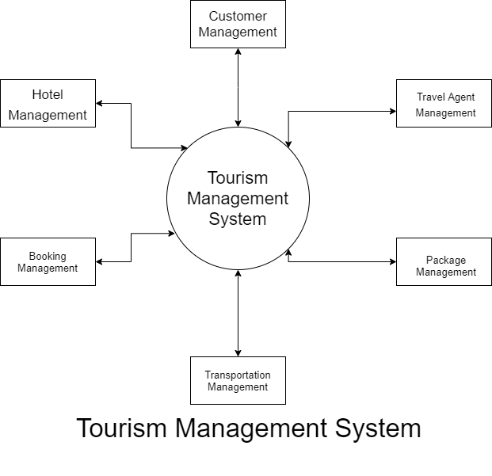
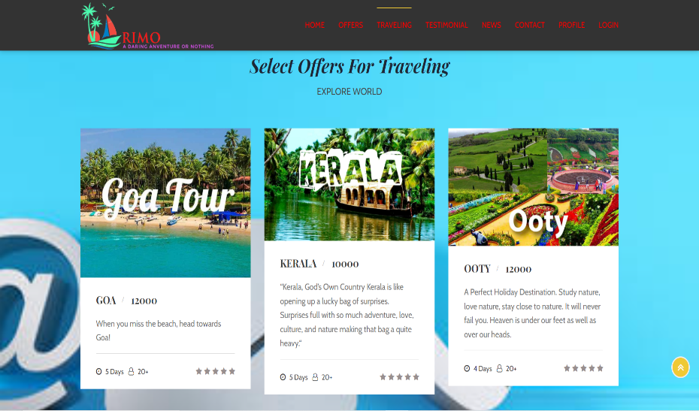
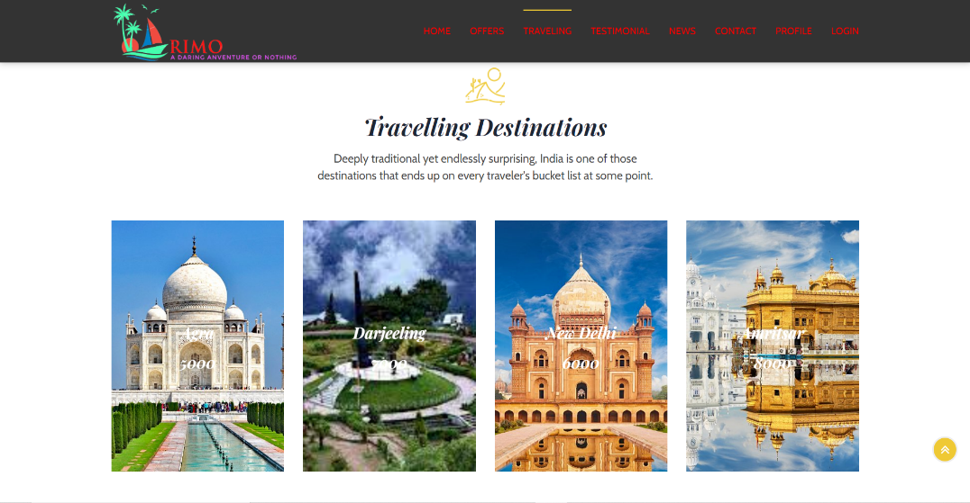
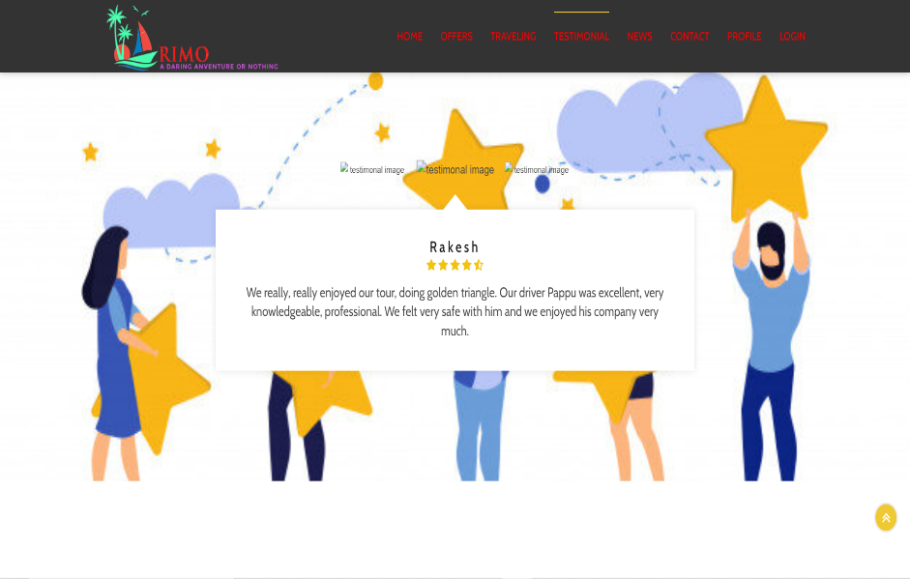
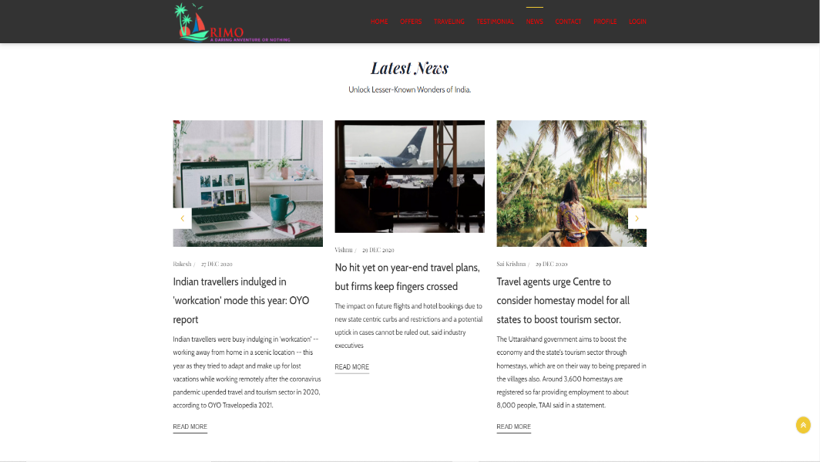
Include Project Title Here
ID-Name of Students :- 190030364 D.Vishnu, 190030581 G.Sai Krishna, 190032064 CH.RAkesh
Faculty Team Names :-
Department of CSE, KLEF
Introduction
Block Diagram
Output Screenshots
Objective
To manage all the travel requirements while providing ease and sort of convenience to the customers.
To add value to the travel sector of different companies
To offer the traveling services at very reasonable prices
Problem Statement
Help the Tourists by building an idea based on homestay which also includes nearby tourism places.
Homestay is a popular form of hospitality and lodging whereby visitors share a residence with a local of the city to which they are traveling. The length of stay can vary from one night to over a year and can be provided gratis (gift economy), provide an online platform solution which connects the homestay providers and the visitors who want to use them while they are travelling.
Proposed Solution
Providing an agreement to the both stakeholders(Terms and Conditions) and also for security Issues both stakeholders verifying their details each other.
By providing an agreement there are no security Issues as we are going under the law.
Easy to locate places to HomeStay
Modules
HOME
OFFERS
TRAVELING
TESTIMONIAL
NEWS
CONTACT
PROFILE
LOGIN
Advantages
Notes:
Introduction - Objective, Problem Statement, Proposed Solution then Advantages of Proposed Solution [First Column] Block Diagram – System Architecture / Project Flow Modules – Mention modules with their operations [Second Column] Output Screenshots – Use this space to include your project screenshots in such a way that all images must be of same size and properly aligned (You can include images side by side also). You can add one more slide of same size to include more screenshots.

